Slide 1
Statistical Modeling
Linear, Multiple and Logistic Regressions

Slide 2
What is Statistical Modeling?
Statistical modeling is the process of applying statistical analysis to a dataset. A statistical model is a mathematical representation (or mathematical model) of observed data.
When data analysts apply various statistical models to the data they are investigating, they are able to understand and interpret the information more strategically. Rather than sifting through the raw data, this practice allows them to identify relationships between variables, make predictions about future sets of data, and visualize that data so that non-analysts and stakeholders can consume and leverage it.
“When you analyze data, you are looking for patterns,” says Mello. “You are using a sample to make an inference about the whole.”

Slide 3
3 Reasons to Learn Statistical Modeling
While data scientists are most often tasked with building models and writing algorithms, analysts also interact with statistical models in their work on occasion. For this reason, analysts who are looking to excel should aim to obtain a solid understanding of what makes these models successful.
“As machine learning and artificial intelligence become more commonplace, more and more companies and organizations are leveraging statistical modeling in order to make predictions about the future based off data,” Mello says. “[So] if you work in the area of data analytics, you need to understand how the underlying models work…No matter what kind of analysis you are doing or what kind of data you are working with, you are going to need to use statistical modeling in some way.”
Some of the benefits that come from having a thorough understanding of statistical modeling.

Slide 4
1. You will be better equipped to choose the right model for your needs.
There are many different types of statistical models, and an effective data analyst needs to have a comprehensive understanding of them all. In each scenario, you should be able to identify not only which model will help best answer the question at hand, but also which model is most appropriate for the data you’re working with.

Slide 5
2. You will be better able to prepare your data for analysis.
Data is rarely ready for analysis in its raw form. To ensure your analysis is accurate and viable, the data must first be cleaned up. This cleanup often includes organizing the gathered information and removing “bad or incomplete data” from the sample.
“Before any statistical model can be completed, you need to explore [and], understand the data,” says Mello. “If there is no quality [in the data], then you can’t really derive any insights from it.”
Once you know how various statistical models work and how they leverage data, it will become easier for you to determine what data is most relevant to the question you are trying to answer, as well.

Slide 6
3. You will become a better communicator.
In most organizations, data analysts are required to communicate their findings with two different audiences. The first audience consists of those on the business team who don’t need to understand the details of your analysis, but simply want to know the key takeaways. The second audience consists of those who are interested in the more granular details; this group will want both the list of broad conclusions and an explanation of how you reached them.

Slide 7
Important Statistical Techniques in Data Analysis
Before any statistical model can be created, an analyst needs to collect or fetch the data housed on a database, clouds, social media, or within a plain excel file. To do this, analysts must also have a solid grasp of data structure and management, including how and where data is stored, fetched, and maintained. Those working in this field should thus share a passion for facts and data, and understand the basics of data manipulation, as well.
Once it comes time to analyze the data, there are an array of statistical models analysts may choose to utilize. According to Mello, most common techniques will fall into the following two groups:
Supervised learning, including regression and classification models.
Unsupervised learning, including clustering algorithms and association rules.

Slide 8
Regression Models
Data analysts use regression models to examine relationships between variables. Regression models are often used by organizations to determine which independent variables hold the most influence over dependent variables—information that can be leveraged to make essential business decisions.
“The most traditional regression models that have been used for a long time are logistic regression, linear regression, and polynomial regression,” Mello says. “These are the most common.”
Other examples of regression models can include stepwise regression, ridge regression, lasso regression, and elastic net regression.

Slide 9
What is regression analysis?
A Pharmacy Company offers this example: Suppose you’re a sales manager trying to predict next month’s sales of a seasonal medicine. You know that dozens, perhaps even hundreds of factors from the weather can affect sales. Your organization has a theory about what will have the biggest effect on sales. “The more rain we have, the more we sell.” “Six weeks after the sell jump.”

Slide 10
Thus, Regression analysis is a way of mathematically sorting out which of those variables does indeed have an impact. It answers the questions: Which factors matter most? Which can we ignore? How do those factors interact with each other? And, perhaps most importantly, how certain are we about all of these factors?

Slide 11
In regression analysis, those factors are called variables. You have your dependent variable — the main factor that you’re trying to understand or predict. In this example, the dependent variable is monthly sales. And then you have your independent variables — the factors you suspect have an impact on your dependent variable.

Slide 12
How does it work?
In order to conduct a regression analysis, you gather the data on the variables in question. (Reminder: you likely don’t have to do this yourself, but it’s helpful for you to understand the process your data analyst colleague uses.) You take all of your monthly sales numbers for, say, the past three years and any data on the independent variables you’re interested in. So, in this case, let’s say you find out the average monthly rainfall for the past three years as well. Then you plot all of that information on a chart that looks like this:

Slide 13
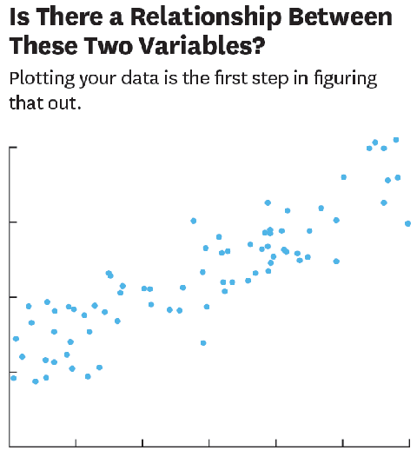

Slide 14
The y-axis is the amount of sales (the dependent variable, the thing you’re interested in, is always on the y-axis) and the x-axis is the total rainfall. Each blue dot represents one month’s data—how much it rained that month and how many sales you made that same month.
Glancing at this data, you probably notice that sales are higher on days when it rains a lot.
Now imagine drawing a line through the chart above, one that runs roughly through the middle of all the data points. This line will help you answer, with some degree of certainty, how much you typically sell when it rains a certain amount.

Slide 15
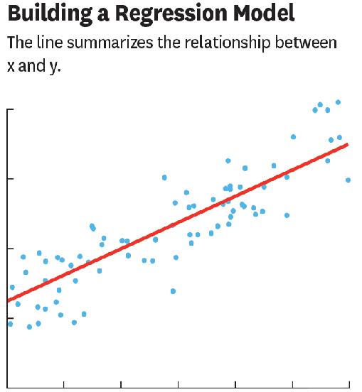
This is called the regression line and it’s drawn (using a statistics program like S or R or even Excel) to show the line that best fits the data. In other words, explains Redman, “The red line is the best explanation of the relationship between the independent variable and dependent variable.”

Slide 16
In addition to drawing the line, your statistics program also outputs a formula that explains the slope of the line and looks something like this:
Y = 200 + 5x + error term
Ignore the error term for now. It refers to the fact that regression isn’t perfectly precise. Just focus on the model:
Y = 200 + 5x

Slide 17
What this formula is telling you is that if there is no “x” then Y = 200. So, historically, when it didn’t rain at all, you made an average of 200 sales and you can expect to do the same going forward assuming other variables stay the same. And in the past, for every additional inch of rain, you made an average of five more sales. “For every increment that x goes up one, y goes up by five,” says the Company.

Slide 18
Multiple linear regression is used to estimate the relationship between two or more independent variables and one dependent variable. You can use multiple linear regression when you want to know:
How strong the relationship is between two or more independent variables and one dependent variable (e.g. how rainfall, temperature, and amount of fertilizer added affect crop growth).
The value of the dependent variable at a certain value of the independent variables (e.g. the expected yield of a crop at certain levels of rainfall, temperature, and fertilizer addition).

Slide 19

How to perform a multiple linear regression:
The formula for a multiple linear regression is:
y = the predicted value of the dependent variable
B₀ = the y-intercept (value of y when all other parameters are set to 0)
B₁X₁= the regression coefficient (B₁) of the first independent variable (X₁) (the effect that increasing the value of the independent variable has on the predicted y value)
… = do the same for however many independent variables you are testing
B_{n}X_{n} = the regression coefficient of the last independent variable
e = model error (how much variation there is in our estimate of y)

Slide 20
Example:
You are a public health researcher interested in social factors that influence heart disease. You survey 500 towns and gather data on the percentage of people in each town who smoke, the percentage of people in each town who bike to work, and the percentage of people in each town who have heart disease.
Because you have two independent variables and one dependent variable, and all your variables are quantitative, you can use multiple linear regression to analyze the relationship between them.

Slide 21
As an example, imagine that you’re a traffic planner in your city and need to estimate the average commute time of drivers going from the East side of the city to the West. You don’t know how long it takes on average, but you do know that it will depend on a number of factors. It probably depends on things like the distance driven, the number of stoplights on the route, and the number of other cars on the road. In that case you could create a linear multiple regression equation like the following:
y = B_1 * Distance + B_2 * Stoplights + B_3 * Cars + A
where y is the average commute time, Distance is the distance between the starting and ending destinations, Stoplights is the number of stoplights on the route, and A is a constant representing other time consumers (E.g. Putting on your seat belt, starting the car, maybe stopping at a coffee shop).

Slide 22
Logistic Regression
Prediction Model: Binary Outcomes

Slide 23
Logistic Regression
• Models relationship between set of variables or
covariates x_{i}.
– dichotomous such as seizure (yes/no)
– categorical (Type of cerebral palsy – Hemiplegic, etc)
– continuous (age, systolic blood pressure, weight, height...)
&
• Binary outcome (Y) variable (deep wound infection, 1= presence or diagnosed case, and 0= absence of deep wound infection)

Slide 24
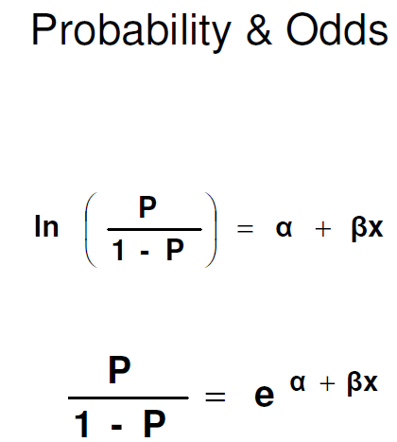

Slide 25
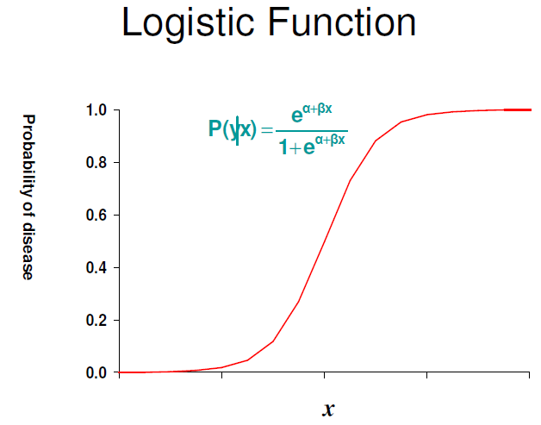

Slide 26
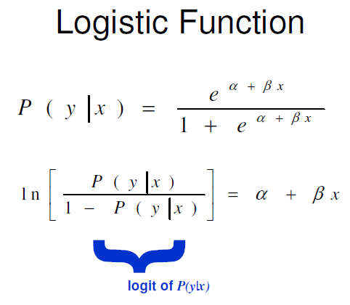

Slide 27
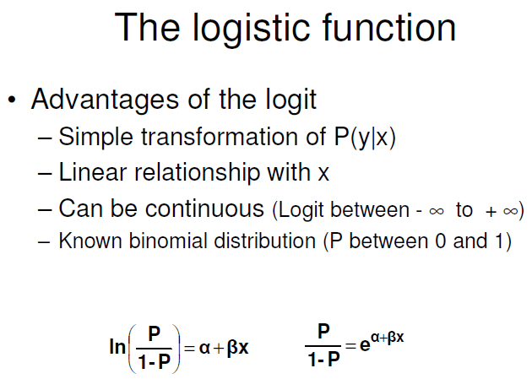

Slide 28
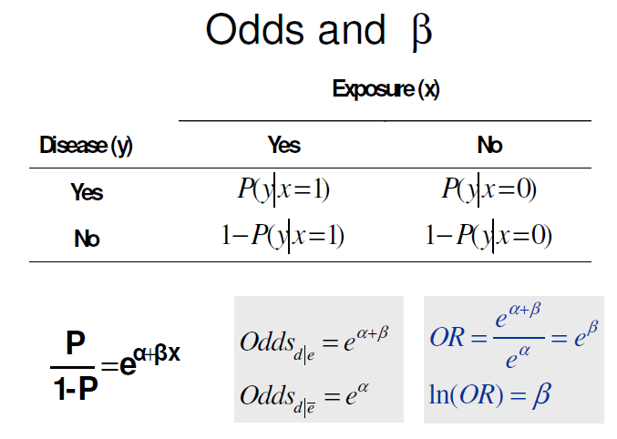

Slide 29
Logistic Regression Example: Credit Card Fraud
The Credit Card Fraud Detection problem is of significant importance to the banking industry because banks each year spend hundreds of millions of dollars due to fraud. When a credit card transaction happens, the bank makes a note of several factors. For instance, the date of the transaction, amount, place, type of purchase, etc. Based on these factors, they develop a Logistic Regression model of whether or not the transaction is a fraud.
For instance, if the amount is too high and the bank knows that the concerned person never makes purchases that high, they may label it as a fraud.

Slide 30
Examples:
To predict whether a person will buy a car (1) or (0)
To know whether the tumor is malignant (1) or (0)
Now let us consider a scenario where you have to classify whether a person will buy a car or not. In this case, if we use simple linear regression, we will need to specify a threshold on which classification can be done.
Let say the actual class is the person will buy the car, and predicted continuous value is 0.45 and the threshold we have considered is 0.5, then this data point will be considered as the person will not buy the car and this will lead to the wrong prediction.
So we conclude that we can not use linear regression for this type of classification problem. As we know linear regression is bounded, So here comes logistic regression where value strictly ranges from 0 to 1.

Slide 31
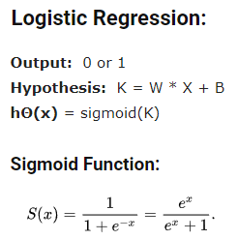

Slide 32
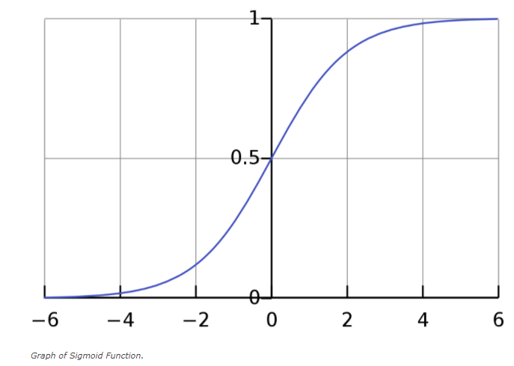

Slide 33
Types of Logistic Regression:
Binary Logistic Regression
Only two possible outcomes(Category). Example: The person will buy a car or not.
Multinomial Logistic Regression
More than two Categories possible without ordering.
Ordinal Logistic Regression
More than two Categories possible with ordering.

Slide 34
REAL-WORLD EXAMPLE WITH PYTHON:
Now we’ll solve a real-world problem with Logistic Regression. We have a Data set having
5 columns namely:
UserID, Gender, Age, EstimatedSalary and Purchased
Now we have to build a model that can predict whether on the given parameter a person will buy a car or not.

Slide 35
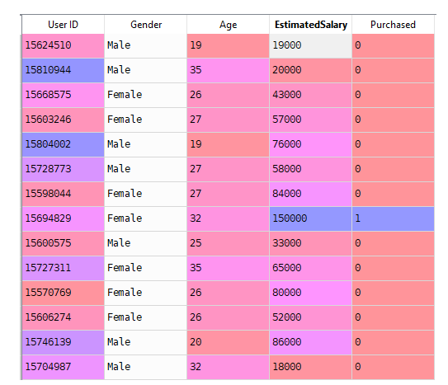
Data Set

